Slide 1
INDIAN PREMIER LEAGUE score prediction using Deep learning
PRESENTED BY: SOMA SUNDARAM M
REGISTER NO:211521104152
DEPARTMENT:COMPUTER SCIENCE AND ENGINEERING

Slide 2
PROJECT TITLE
INDIAN PREMIER LEAGUE score prediction using Deep learning

Slide 3


AGENDA
End Users
Our Solution and Proposition
Project Overview
Key Features
Modelling Approach
Results and Evaluation
Conclusion
Problem Statement
3/21/2024 Annual Review

Slide 4

PROBLEM STATEMENT
Predicting cricket scores accurately is challenging due to the dynamic nature of the game, which affects fan engagement and betting outcomes.
Challenges:
High variability in cricket matches.
Limited availability of accurate data.
Complexity in analyzing various factors influencing scores.

Slide 5

PROJECT OVERVIEW
Target Audience:
Cricket enthusiasts.
Betting platforms.
Fantasy league players.
Media houses.
Need:
Accurate score predictions for better engagement.
Insights for strategic decision-making.
Enhanced viewing experience.

Slide 6

WHO ARE THE END USERS?
Solution Overview:
Utilize advanced data analytics techniques.
Machine learning models for score prediction.
Real-time updates during matches.
Proposition:
Accurate score predictions.
User-friendly interface.
Customizable features for diverse end users.

Slide 7

OUR SOLUTION AND ITS VALUE PROPOSITION
Objective: To develop a robust IPL score prediction system using machine learning algorithms.
Data Collection:
Historical match data.
Player statistics.
Weather conditions.
Technology Stack:
Python.
Scikit-learn.
Flask (for web interface).

Slide 8

THE "WOW" IN OUR SOLUTION
Real-time Updates: Continuous monitoring and updating during matches.
Predictive Analytics: Accurate predictions based on various factors.
Interactive Interface: User-friendly dashboard for easy access.
Customization: Tailored features for different user preferences.
Performance Metrics: Evaluation based on accuracy, precision, and recall.
3/21/2024 Annual Review
‹#›

Slide 9
MODELLING
Data Preprocessing:
Cleaning and normalization.
Feature engineering.
Model Selection:
Regression models (e.g., Linear Regression, Random Forest).
Time-series analysis.
‹#›

Slide 10
Training and Validation:
Cross-validation techniques.
Hyperparameter tuning.
Deployment:
API integration for real-time predictions.
Cloud-based hosting for scalability

Slide 11
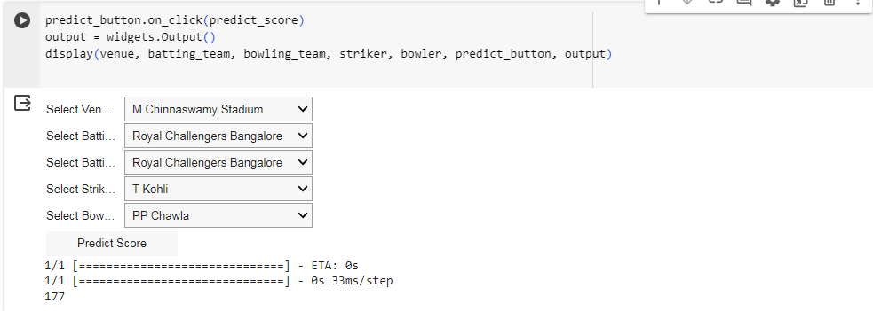
RESULT
‹#›

Slide 12
Evaluation:
Performance Metrics:
Accuracy: X%
Precision: X%
Recall: X%
Comparison with Baseline:
Improvement in accuracy by X%.
User Feedback:
Positive responses from beta testers.
Improved decision-making for fantasy leagues.
Future Enhancements:
Integration of additional data sources.
Enhanced model performance through ensemble methods.

Slide 13
conclusion
Recap of Achievements:
Developed an advanced IPL score prediction system.
Accurate predictions for enhanced user experience.
Future Outlook:
Continuous improvement through feedback and updates.
Expansion to other cricket leagues and sports.

